Slide 1
GEARS
🚗🏎🚜🚲🚛
direction

Slide 2
In this challenge you will learn how the gears’ direction change

Slide 3
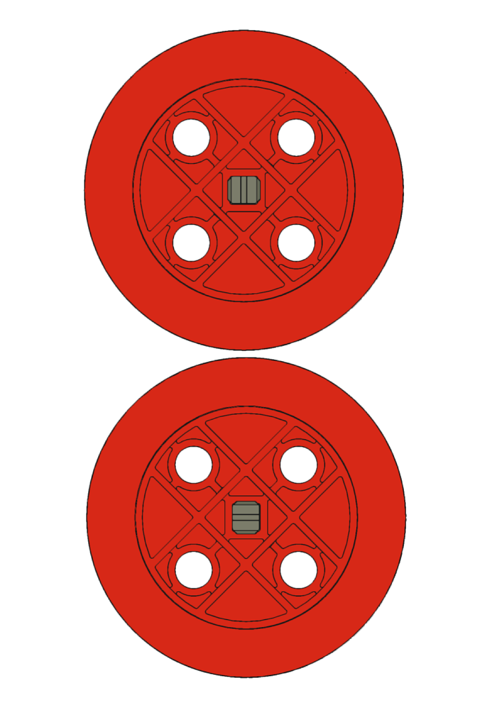
When two gears don’t touch, they have no effect on each other

Slide 4
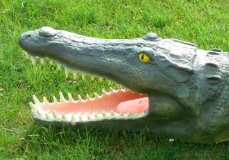
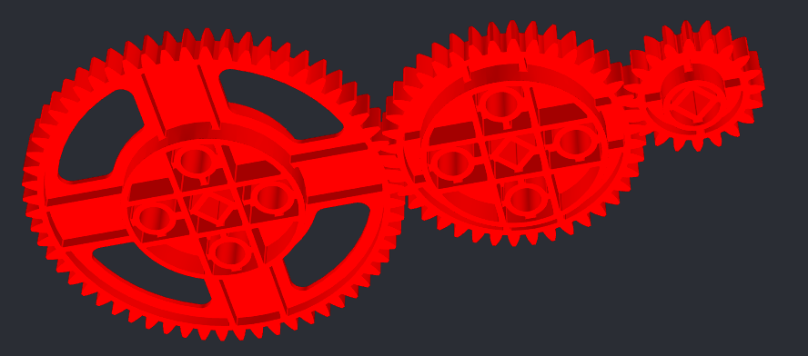
The power is in the teeth

Slide 5
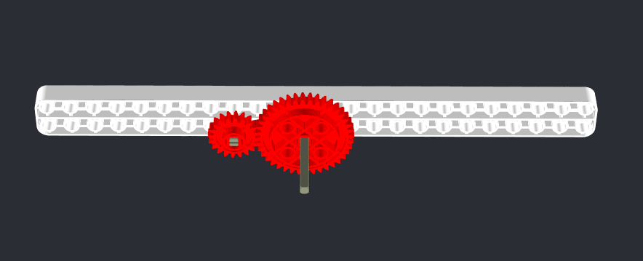
Gear train: the second gear (follow gear) will move in the opposite direction of the first gear (drive gear)

Slide 6
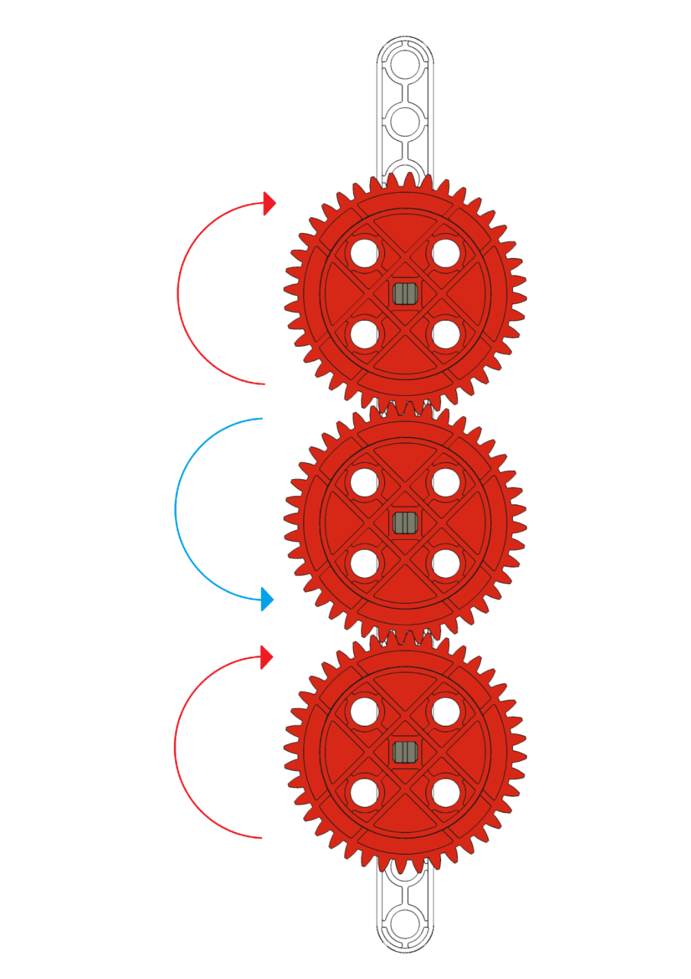
Now let’s use another gear. The direction will change again, the new follow gear will move in the same direction of the drive gear.

Slide 7
You’ve got this!
If we continued to build the gear train, in what direction would the fifth gear rotate?

Slide 8
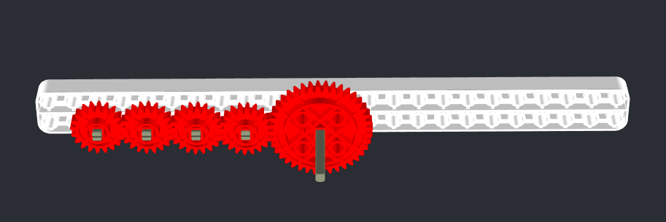
answer
The same direction of the drive gear.

Slide 9
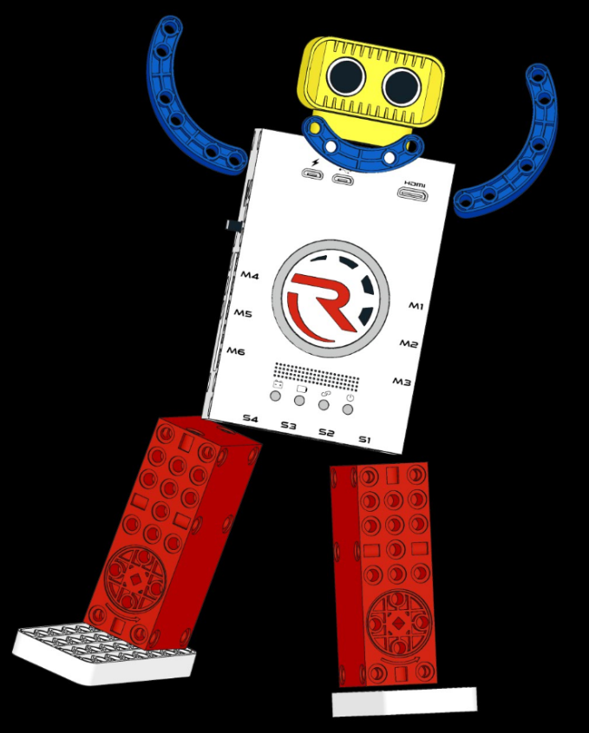
Good job!!!

